Slide 1
The Analysis of the Canadian Housing Crisis
By Akshay, Jill, Jonathan, Thu, and Ritvik

Slide 2
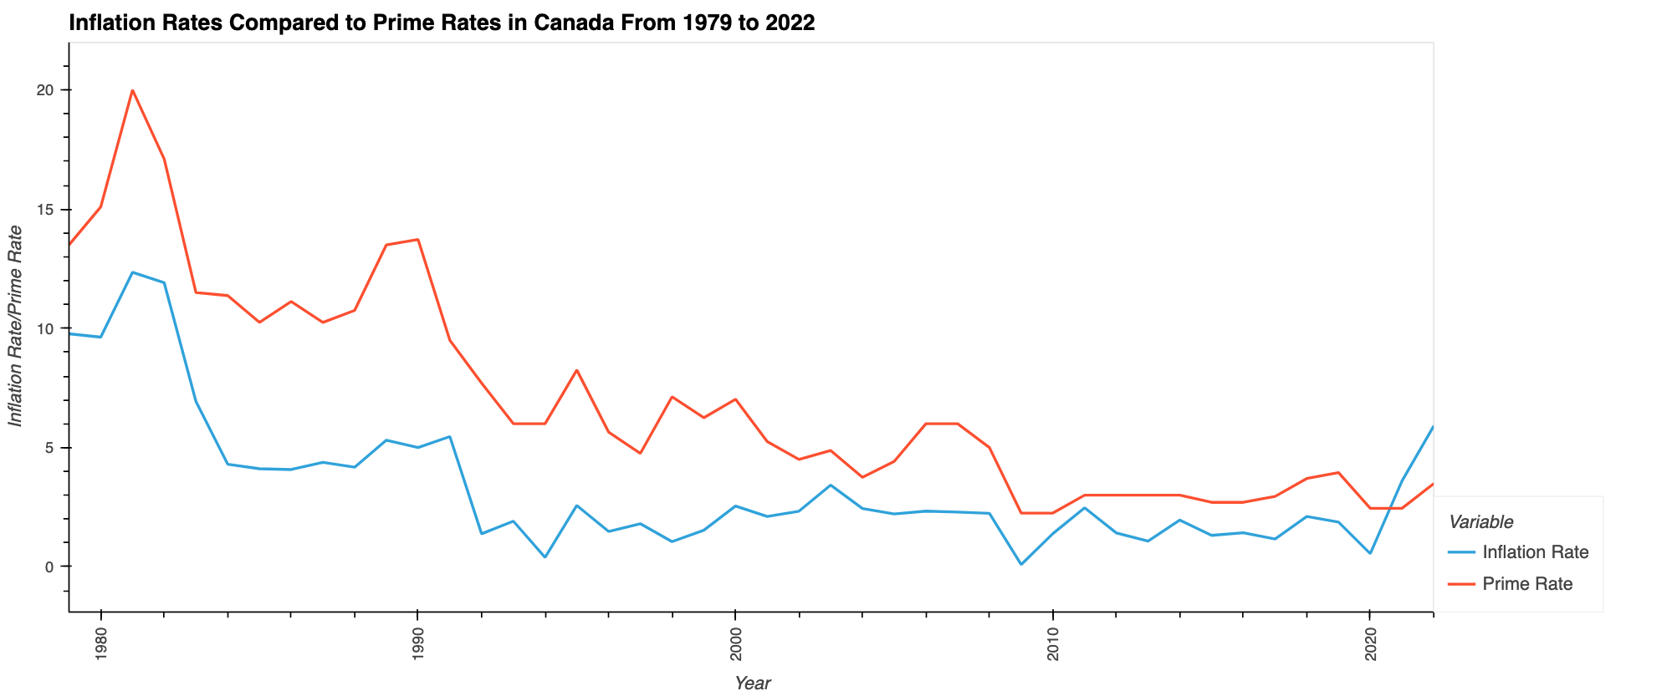
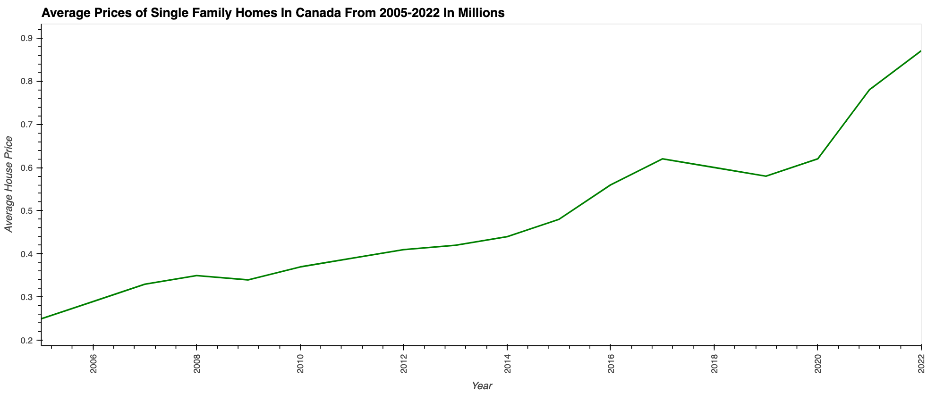
Are We In a Housing Crisis?
The question of a possible housing crisis is something that many are speculating due to certain economic indicators pointing towards it. Looking at the data from the charts above, we can see that housing prices, inflation rates and interest rates have all taken a sudden uptrend due to COVID-19. This data indicates that we may be experiencing a housing crisis because rising housing prices will cause higher demand due to housing becoming significantly less affordable. To combat this, interest rates have risen quite drastically recently to counter this, however, this may have a net negative affect since it is becoming much more expensive to get a mortgage.
Notes:
The housing market is affected by a wide range of factors. As the population rises, so does the need for homes, and as a result, housing prices. The primary driver of increased housing demand is the pressing necessity of home ownership. The housing market is highly sensitive to changes in interest rates. Interest rates can drastically impact a homebuyer's abilities. Lower interest rates make it cheaper to get a mortgage to buy a property, which increases demand for real estate and raises prices. Inflation typically causes home prices to follow the same pattern as those of other 'products. As inflation rises, house prices slow. As shown, interest rate and inflation affect house prices more than population.

Slide 3
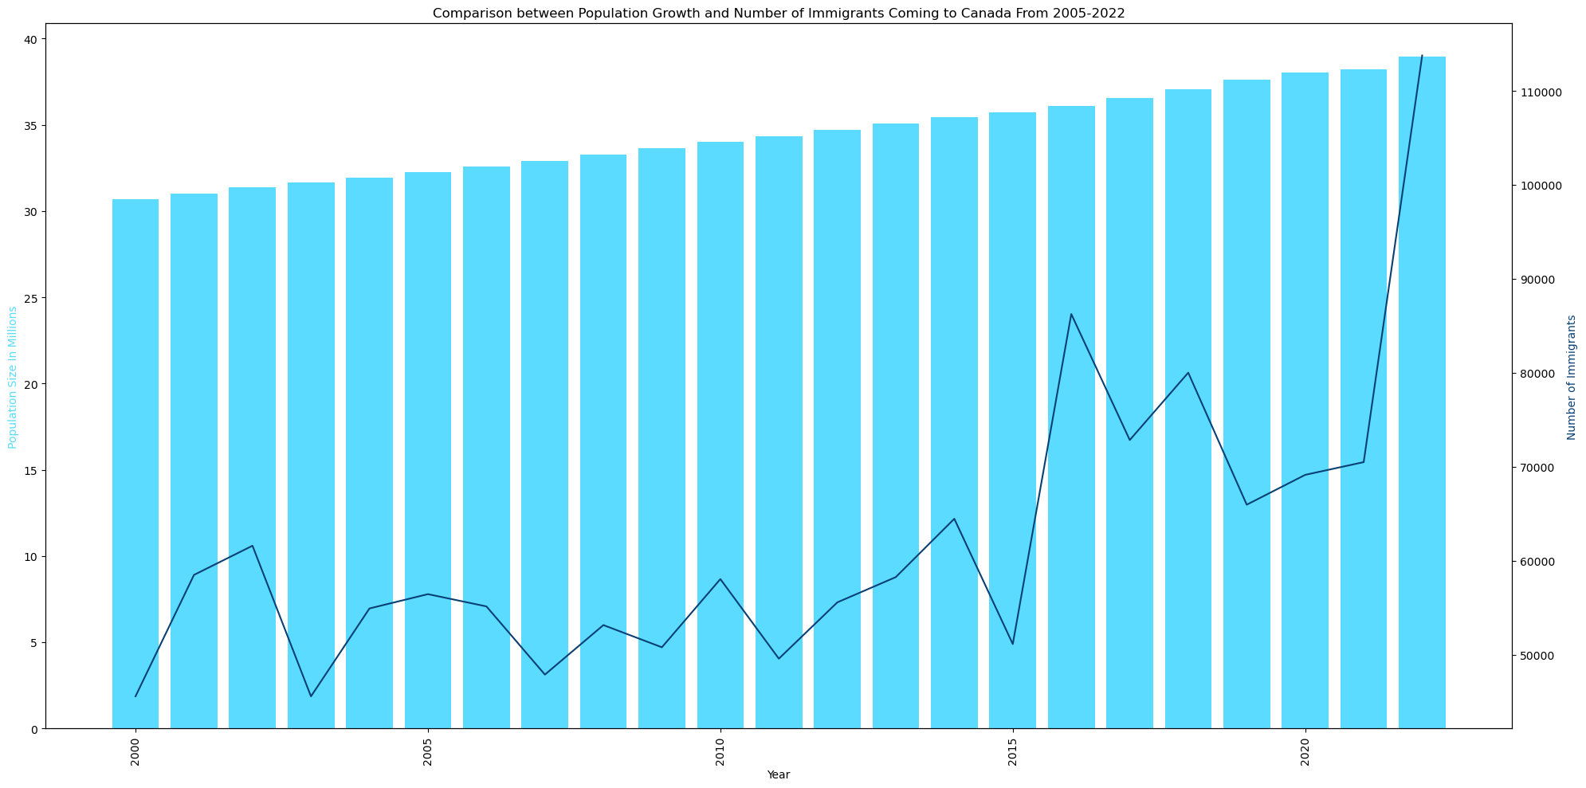
Is there an Impact on Housing from Population Growth and Immigration?
This chart comparing population growth to the number of immigrants coming to Canada from 2005-2022 indicates that there has been a surplus of immigration in canada since the beginning of 2020. As more immigrants move to Canada, they will need places to live which may lead to higher demands for housing and increased housing prices.

Slide 4
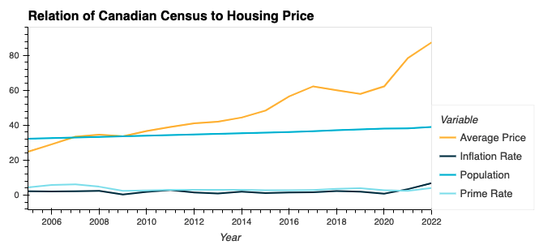
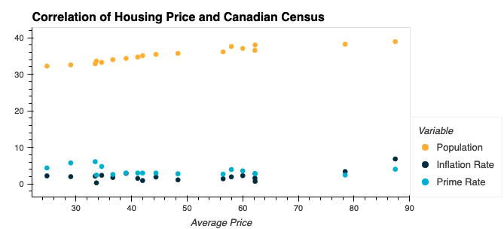
What is the Correlation of the Above Factors to Housing?
Increases in population, interest rates, and inflation have all contributed to rising home prices. Housing prices however have increased at a much rapid rate in comparison to population increases. This suggests that prime rates and inflation have a larger correlation to housing prices than population does

Slide 5
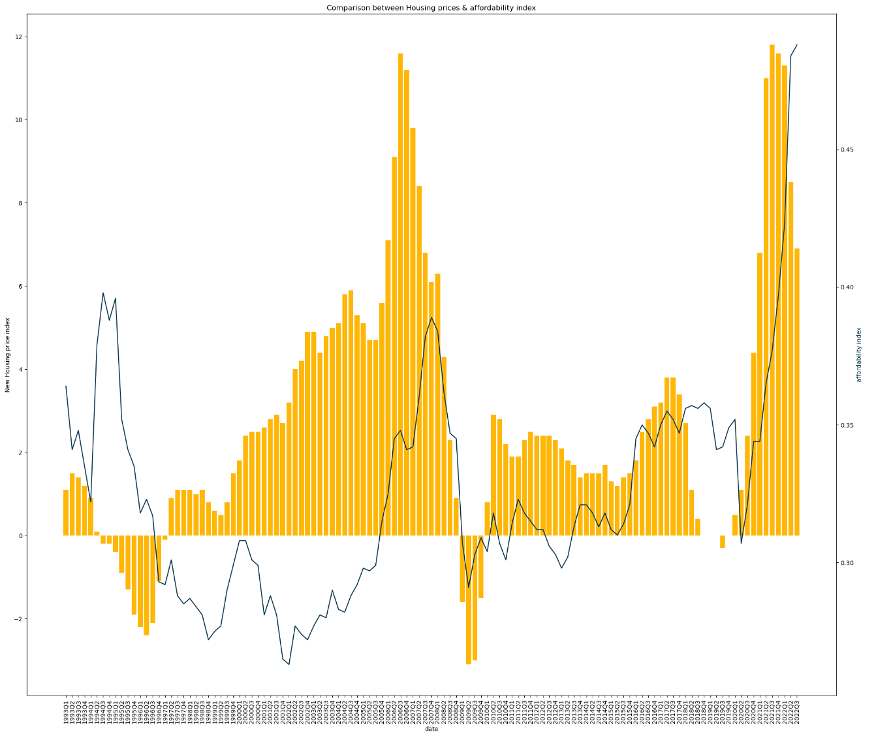
How Unaffordable has the Housing Market Become?
This graph compares the new house price index with affordability index for the Canadian Housing market. The timeline is from 1993 to 2022. And the conclusion that can be drawn here is, although affordability index has increased in recent years, the new house price index has gone up at a much high rate in comparison. (Source - Bank of Canada)

Slide 6
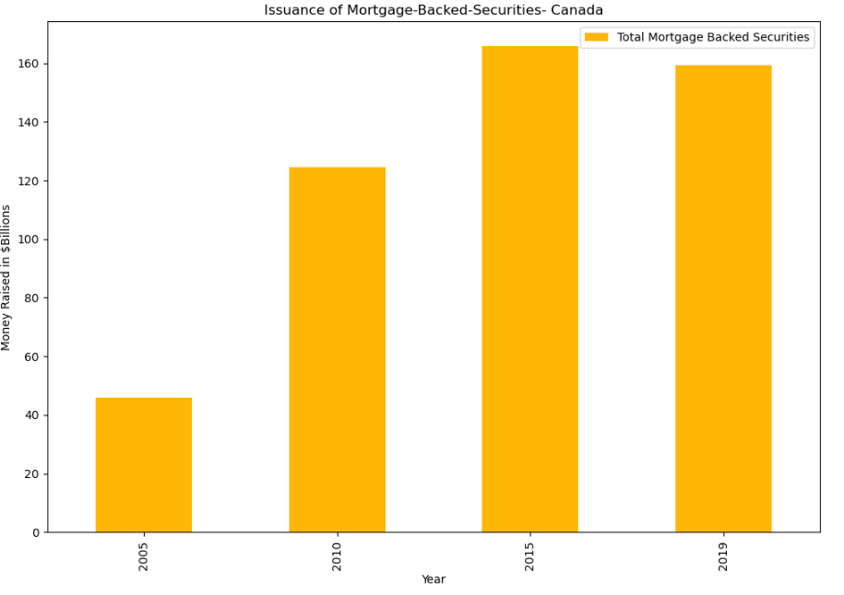
How do Mortgage-Backed Securities Play a Role in Housing Prices?
This bar chart clearly shows the rapid increase in issuance of mortgage-backed securities in the Canadian market from 2005-2019. And as its name suggests, this also illustrates how the amount of mortgage issued across Canada has more than tripled during this time span. (Source- Canada Mortgage & Housing Corporation)

Slide 7
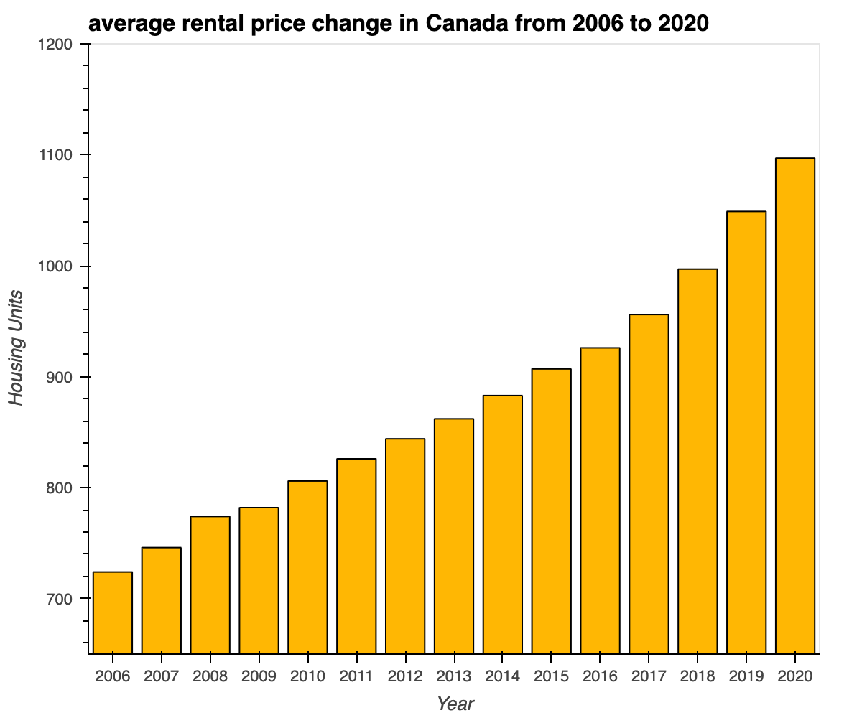
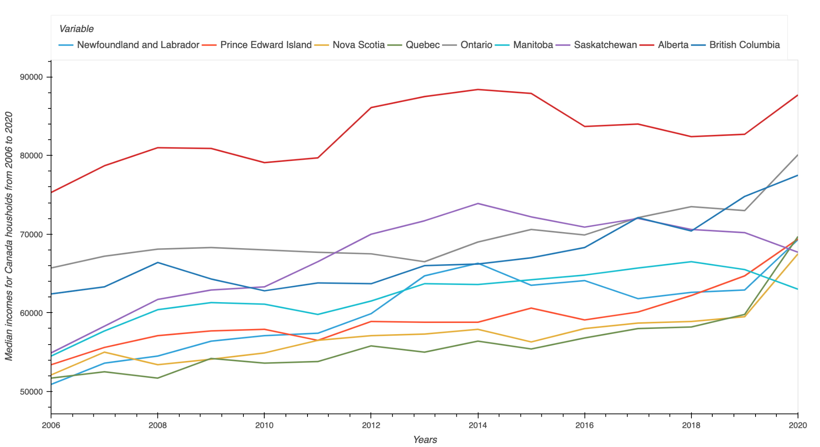
How does Rental Markets Compare to Income Earned Over Time?
Average rent prices in Canada
Median Income in Canada
There is an increasing trend in the current Rental market and in cities like Toronto and Vancouver rental prices have spiked up to 30% in 2022
On Average every Canadian Personal income ranges between 50K-80K per year. If this is compared to the current rental market, Every household is almost spending 30% to 40% of their income on rental and leasing purposes

Slide 8
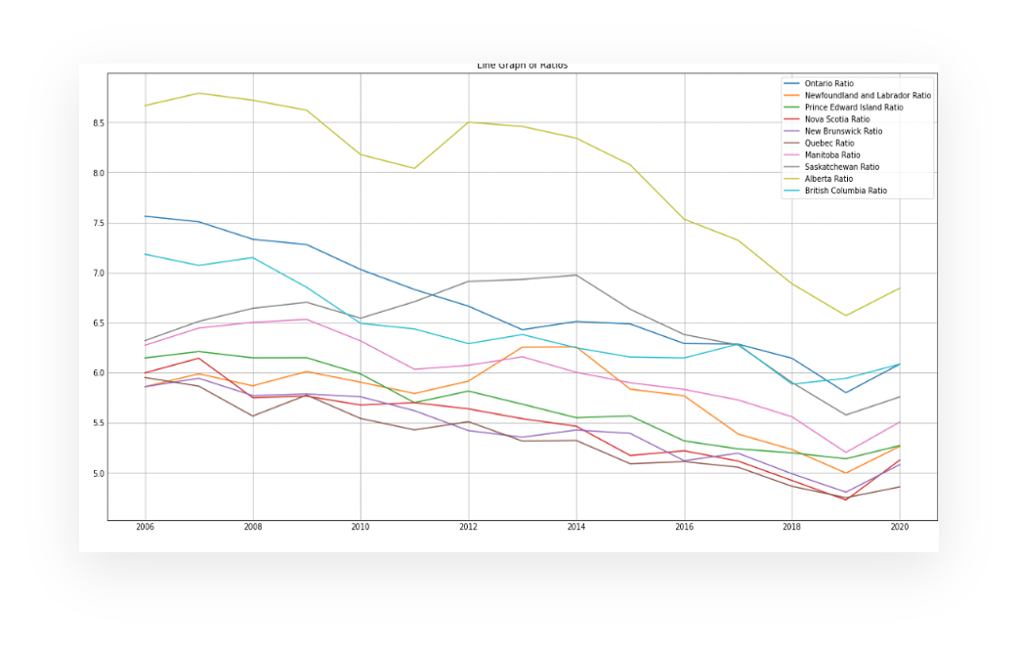
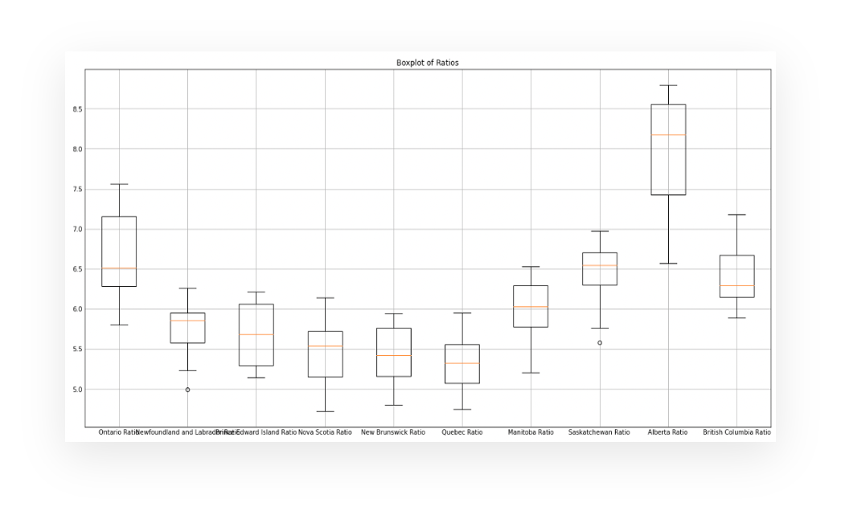
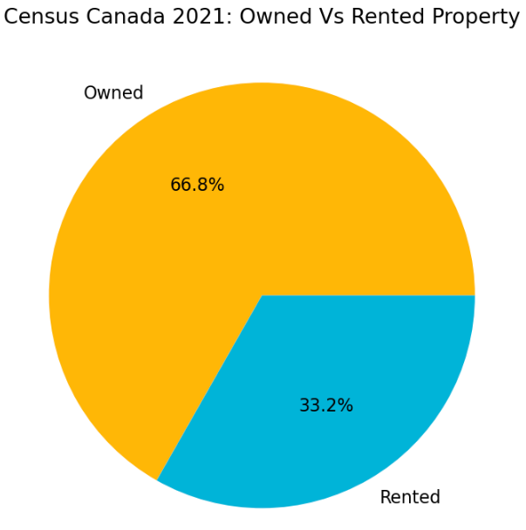
When Should you Buy or Rent Within the Canadian Market?
Price to Rent ratio is one of the important factors that could be used by an individual to make decisions.
Price to rent ratio | Indication
1-15 | Most likely better to buy than rent
16-20 | Typically better to buy than rent
21+ | Better to rent than buy
file:///Users/akshaynyamala/Documents/Project_1/housing_price_map.html

Slide 9
The Analysis of the Canadian Housing Crisis
By Akshay, Jill, Jonathan, Thu, and Ritvik

Slide 10
Are We In a Housing Crisis?
The question of a possible housing crisis is something that many are speculating due to certain economic indicators pointing towards it. Looking at the data from the charts above, we can see that housing prices, inflation rates and interest rates have all taken a sudden uptrend due to COVID-19. This data indicates that we may be experiencing a housing crisis because rising housing prices will cause higher demand due to housing becoming significantly less affordable. To combat this, interest rates have risen quite drastically recently to counter this, however, this may have a net negative affect since it is becoming much more expensive to get a mortgage.
Notes:
The housing market is affected by a wide range of factors. As the population rises, so does the need for homes, and as a result, housing prices. The primary driver of increased housing demand is the pressing necessity of home ownership. The housing market is highly sensitive to changes in interest rates. Interest rates can drastically impact a homebuyer's abilities. Lower interest rates make it cheaper to get a mortgage to buy a property, which increases demand for real estate and raises prices. Inflation typically causes home prices to follow the same pattern as those of other 'products. As inflation rises, house prices slow. As shown, interest rate and inflation affect house prices more than population.

Slide 11
Is there an Impact on Housing from Population Growth and Immigration?
This chart comparing population growth to the number of immigrants coming to Canada from 2005-2022 indicates that there has been a surplus of immigration in canada since the beginning of 2020. As more immigrants move to Canada, they will need places to live which may lead to higher demands for housing and increased housing prices.

Slide 12
What is the Correlation of the Above Factors to Housing?
Increases in population, interest rates, and inflation have all contributed to rising home prices. Housing prices however have increased at a much rapid rate in comparison to population increases. This suggests that prime rates and inflation have a larger correlation to housing prices than population does

Slide 13
How Unaffordable has the Housing Market Become?
This graph compares the new house price index with affordability index for the Canadian Housing market. The timeline is from 1993 to 2022. And the conclusion that can be drawn here is, although affordability index has increased in recent years, the new house price index has gone up at a much high rate in comparison. (Source - Bank of Canada)

Slide 14
How do Mortgage-Backed Securities Play a Role in Housing Prices?
This bar chart clearly shows the rapid increase in issuance of mortgage-backed securities in the Canadian market from 2005-2019. And as its name suggests, this also illustrates how the amount of mortgage issued across Canada has more than tripled during this time span. (Source- Canada Mortgage & Housing Corporation)

Slide 15
How does Rental Markets Compare to Income Earned Over Time?
Average rent prices in Canada
Median Income in Canada
There is an increasing trend in the current Rental market and in cities like Toronto and Vancouver rental prices have spiked up to 30% in 2022
On Average every Canadian Personal income ranges between 50K-80K per year. If this is compared to the current rental market, Every household is almost spending 30% to 40% of their income on rental and leasing purposes

Slide 16
When Should you Buy or Rent Within the Canadian Market?
Price to Rent ratio is one of the important factors that could be used by an individual to make decisions.
Price to rent ratio | Indication
1-15 | Most likely better to buy than rent
16-20 | Typically better to buy than rent
21+ | Better to rent than buy
file:///Users/akshaynyamala/Documents/Project_1/housing_price_map.html

Slide 17
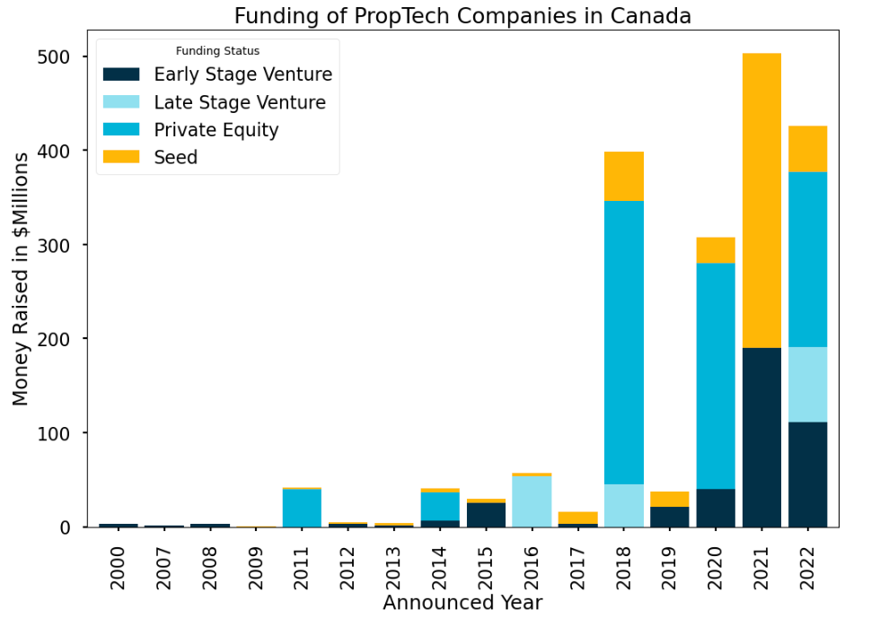
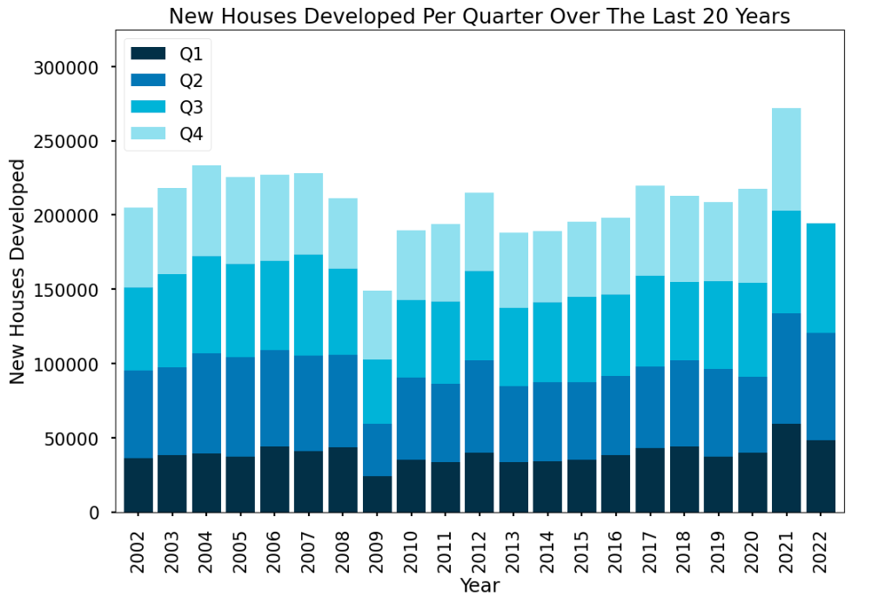
What are Some Key Factors that Could Make Housing Affordable?
Q4 2022 Data Expected to Surpass 2020 New Developments Significantly
Huge Increase in Investment within the PropTech space within Canada over the last couple years, especially in early-stage and seed stage companies in 2021
Companies in PropTech such as Pine, Properly, and Addy increase affordability and introduce alternative payment options to potential homeowners
Investment in PropTech within Canada increased by 78% over the last decade
New Development properties are increasing substantially to keep up with the high demand for housing within Canada
In fact, new developments grew by 24.8% from 2020 to 2021. These properties are on track to develop over the next couple years
Even while facing economic downturn in 2022 with rising costs of inputs, 2022 is also on track to have more developments than prior years excluding 2021

Slide 18
References
Real estate market: Definitions, graphs and data - Bank of Canada
Mortgage-Backed Securities Securitization Reports (cmhc-schl.gc.ca)
Crunchbase- Data on PropTech Companies
Statista- New Housing Developments in Canada per Quarter

Slide 19
What are Some Key Factors that Could Make Housing Affordable?
Q4 2022 Data Expected to Surpass 2020 New Developments Significantly
Huge Increase in Investment within the PropTech space within Canada over the last couple years, especially in early-stage and seed stage companies in 2021
Companies in PropTech such as Pine, Properly, and Addy increase affordability and introduce alternative payment options to potential homeowners
Investment in PropTech within Canada increased by 78% over the last decade
New Development properties are increasing substantially to keep up with the high demand for housing within Canada
In fact, new developments grew by 24.8% from 2020 to 2021. These properties are on track to develop over the next couple years
Even while facing economic downturn in 2022 with rising costs of inputs, 2022 is also on track to have more developments than prior years excluding 2021

Slide 20
References
Real estate market: Definitions, graphs and data - Bank of Canada
Mortgage-Backed Securities Securitization Reports (cmhc-schl.gc.ca)
Crunchbase- Data on PropTech Companies
Statista- New Housing Developments in Canada per Quarter

